Slide 1

Smart Application Tracking System
SANDHYA S (210701226)
SHANDIYA N S (210701240)

Slide 2
INTRODUCTION
Focus:
Our project explains how digitalization has improved the recruitment process through the implementation of Applicant Tracking Systems (ATS).
What is an ATS ?
An Applicant Tracking System (ATS) is a digital tool used by companies to help manage the hiring process.
How ATS Improves Recruitment ?
ATS makes it easier to find and hire the right people for jobs.
It saves time and money by streamlining the recruitment process
Benefits of Digital Recruitment:
Makes the hiring process more efficient and effective.
Helps reach a larger pool of potential employees.
Importance of Effective Recruiting:
Selecting the wrong individual is costly and time-consuming.
Traditional recruitment methods are often insufficient.

Slide 3
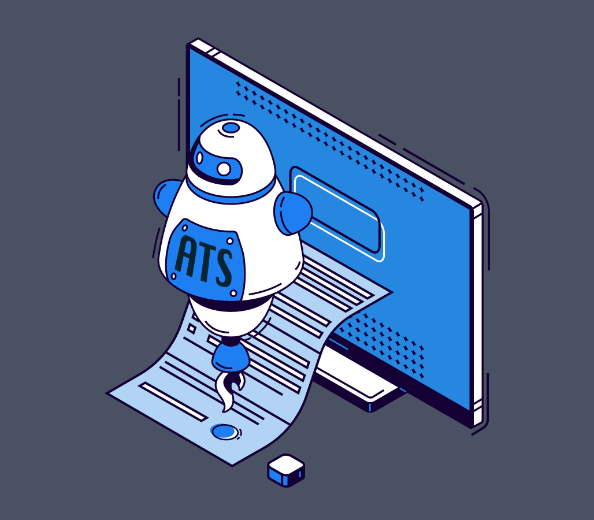
FOCUS OF THE PROJECT
Enable users to drag and drop or browse files for uploading resumes.
Match job descriptions with profile summaries.
Identify and highlight missing keywords in the profile compared to the job description.

Slide 4


1.Streamlit
2. PyPDF2
LIBRARIES USED
3. Google Generative AI
4. Python-dotenv

Slide 5

Purpose of the libraries
Streamlit:
Streamlit is used for creating interactive web applications quickly and easily, particularly useful for data science and machine learning projects.
PyPDF2:
PyPDF2 is a library for working with PDF files.
We can extract information from PDFs, merge PDFs, and manipulate PDF content.

Slide 6
Purpose of the libraries
Google Generative AI :
This library allows you to integrate Google’s generative AI capabilities into your projects.
It can be used for tasks such as natural language processing, image generation, and other AI-driven functionalities.
Python-dotenv :
Python-dotenv is used to manage environment variables

Slide 7
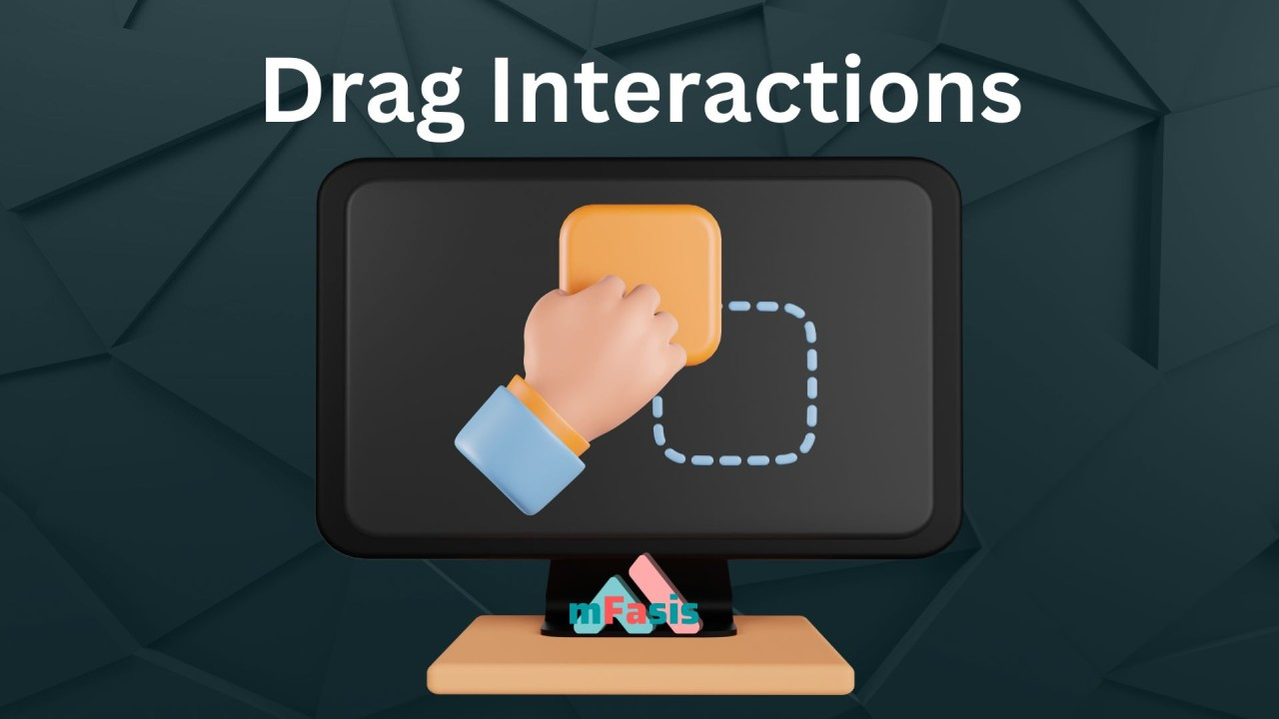

USER EXPERIENCE: Resume Uploading
DRAG AND DROP INTERFACE
FILE BROWSING CAPABILITY

Slide 8
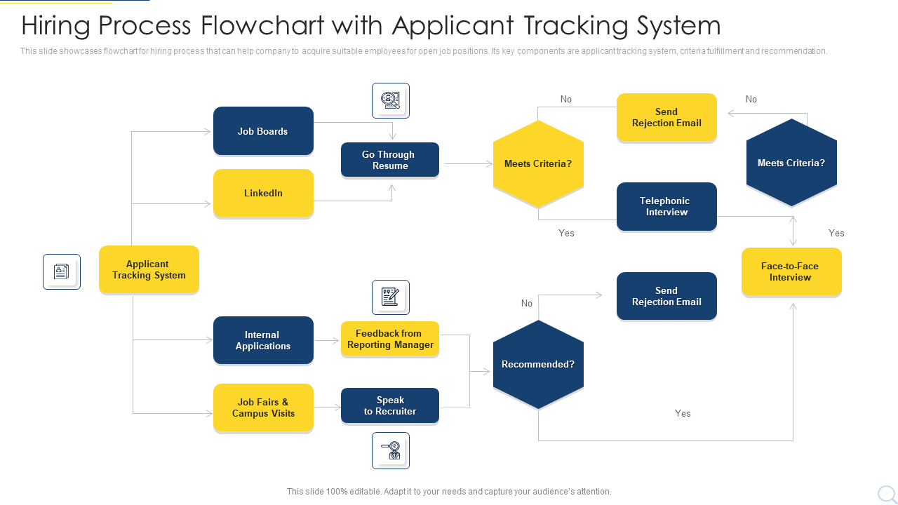
FLOW DIAGRAM

Slide 9
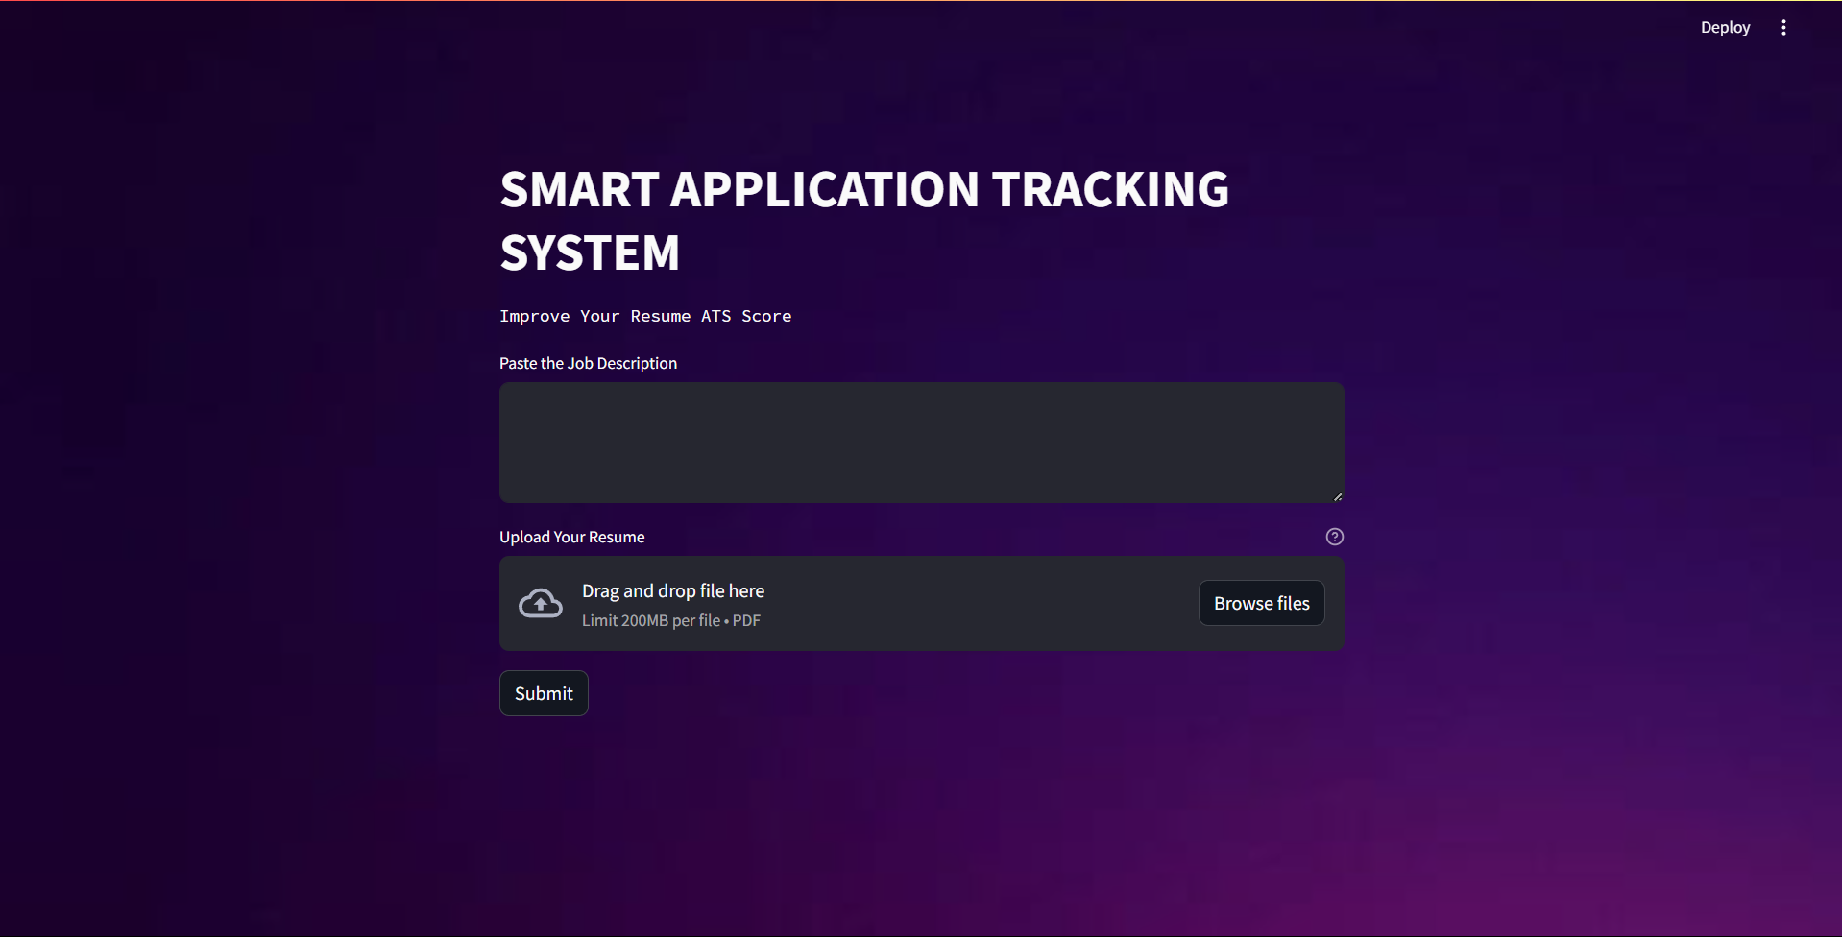
OUTPUT

Slide 10
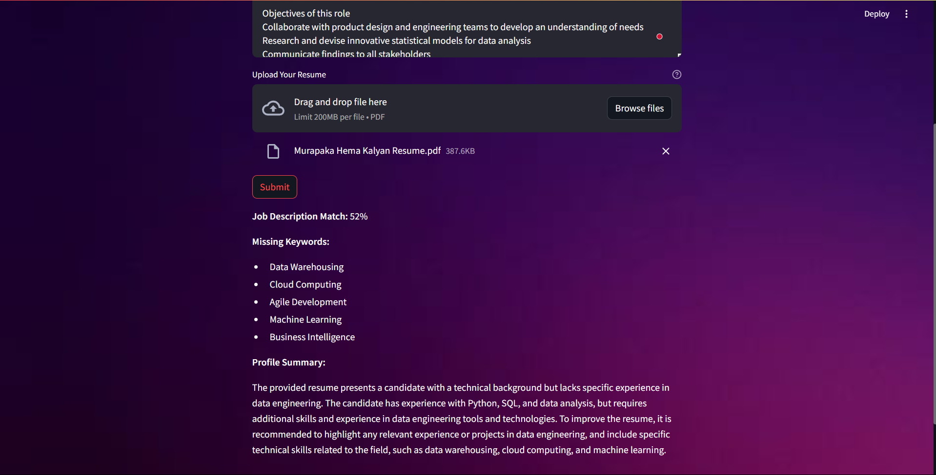
OUTPUT

Slide 11
CONCLUSION
The ATS system project effectively utilizes Streamlit, PyPDF2, Google Generative AI, and Python-dotenv to create a robust and user-friendly platform.
Streamlit enables the creation of an interactive web interface, allowing users to easily upload resumes via drag-and-drop or file browsing. PyPDF2 handles PDF manipulation, extracting necessary information from resumes for efficient processing. Google Generative AI provides advanced natural language processing and keyword analysis, helping to match job descriptions with profiles and highlight missing keywords. Python-dotenv manages environment variables securely, ensuring smooth configuration and deployment.
Overall, this integration of modern libraries results in a powerful ATS system that enhances the recruitment process by streamlining resume submission, improving matching accuracy, and aiding candidates in optimizing their profiles.

Slide 12
THANK YOU

